Slide 1

Problems on Conditional Expectation 2018

Slide 2
Reference
Data
Youtube
Code

Slide 3
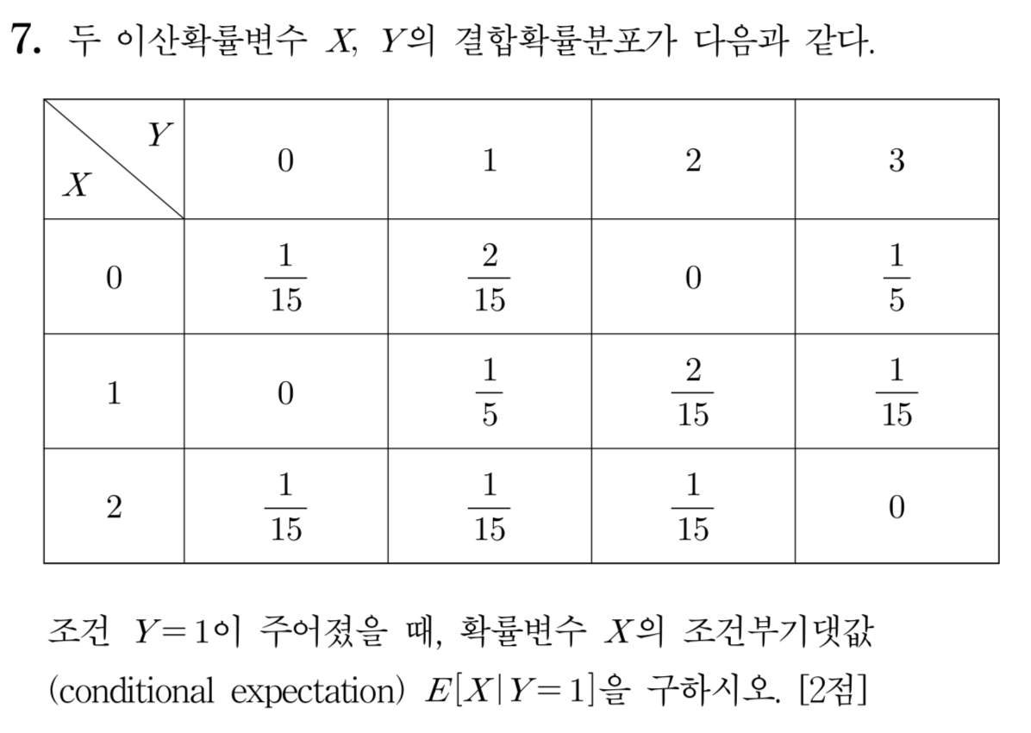
[2018]

Slide 4


Slide 6
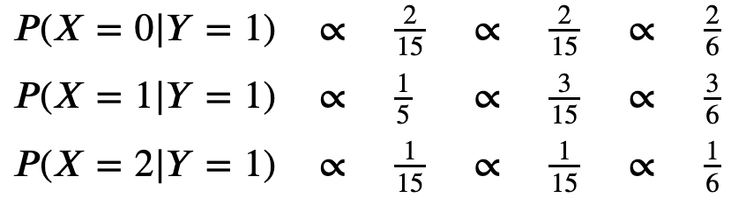
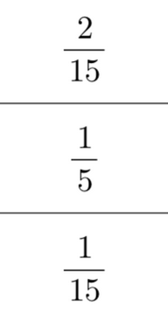

Slide 10
